Slide 1

Training Workshop
Session 4: Load and step

Slide 2
ABAQUS Tutorial
Dynamic &
Contact FEA
Postprocessing
ABAQUS
Material &
Section Properties
Job Processing
(Solver)
Load & step
Loading &
Analysis Steps
Meshing

Slide 3
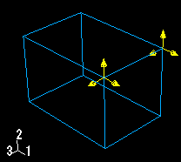
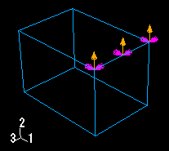
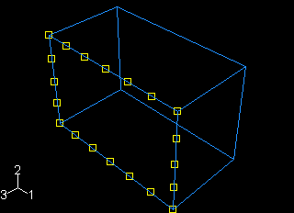
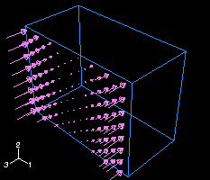
ABAQUS Load
Loading and symbols
A concentrated force
A boundary condition applied to an edge
A uniform temperature field
Variation of a pressure load over a face

Slide 4
ABAQUS Step
Step
  The initial step
  Analysis steps
    General analysis steps
    linear perturbation
Output requests
  Field output
  History output
The variables of interest
The region of which the values are written to the output database.
The rate at which the are written to the output database.

Slide 5
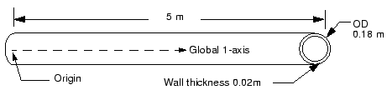
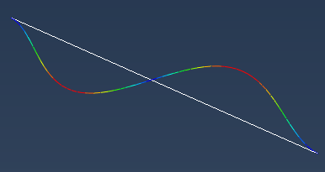
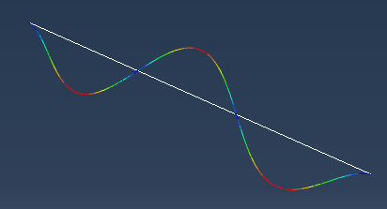
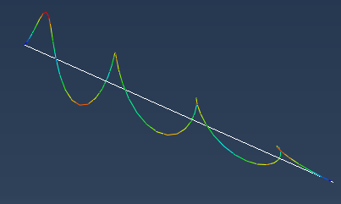
ABAQUS Load and Step
Pipe Vibration Analysis
Three-dimensional beam elements
Clamped firmly at one end and can move only
axially at the other end
Axial tension when in service
The lowest vibrational mode of the unloaded structure
is 40.1 Hz
QUESTION:
To ensure that the section does not resonate
?? LOAD??
Lowest vibrational mode is higher than 50 Hz(desired loading)
Hint: Start by considering a load magnitude of 4 MN

